Slide 1
Chapter 1
Introduction to web development

Slide 2
Objectives (part 1)
Applied
Use a Chrome to run JavaScript applications that are on the Internet, your computer, or a local server.
Use Chrome’s developer tools to find the JavaScript statement that caused an error in a JavaScript application.
Use an IDE or text editor such as VS Code to edit HTML, CSS, and JavaScript files.
If you’re using an IDE or text editor such as VS Code that lets you run web applications from it, use your IDE or text editor to run an application.
Knowledge
Describe the components of a web application.
Describe HTTP requests and responses.

Slide 3
Objectives (part 2)
Distinguish between static web pages and dynamic web pages.
Describe the use of JavaScript in a web application.
Describe the ECMAScript specification.
Describe browser support for the ECMAScript specification.
Describe the use of HTML and CSS.
Distinguish between the HTML5 semantic elements and the HTML div and span elements.
Describe the use of these HTML attributes: id, class, title, for, and name.
Describe the coding for these types of CSS selectors: type, id, and class.
Describe the components of a CSS style rule.
Describe the components of a URL.

Slide 4
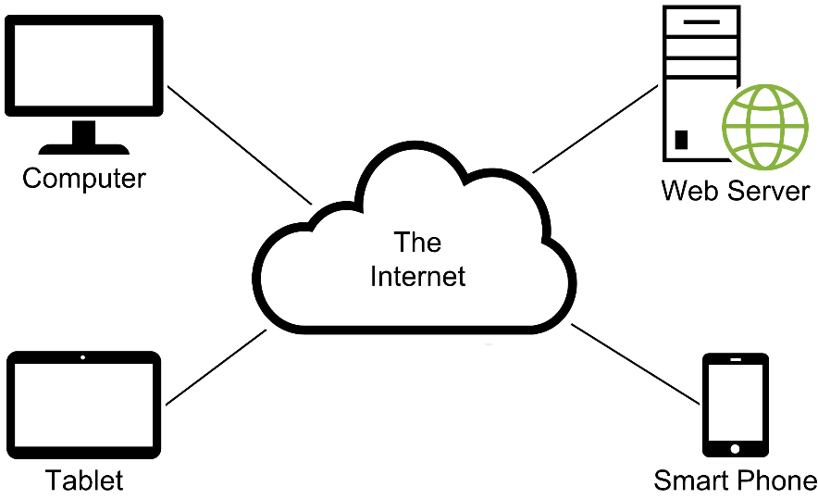
The components of a web application

Slide 5
Terms related to web applications
client
web browser
web server
network
intranet
local area network (LAN)
Internet
wide area network (WAN)
Internet Service Provider (ISP)

Slide 6
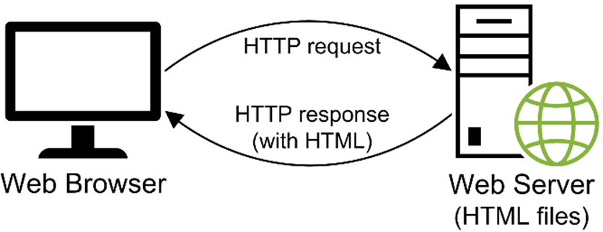
How a web server processes a static web page
Terms related to static web pages
Hypertext Markup Language (HTML)
static web page
HTTP request
HTTP response
rendering a page

Slide 7
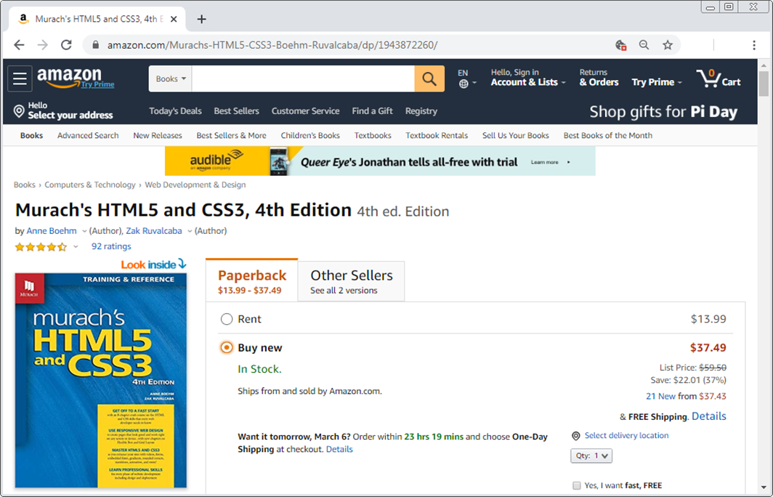
A dynamic web page at amazon.com

Slide 8
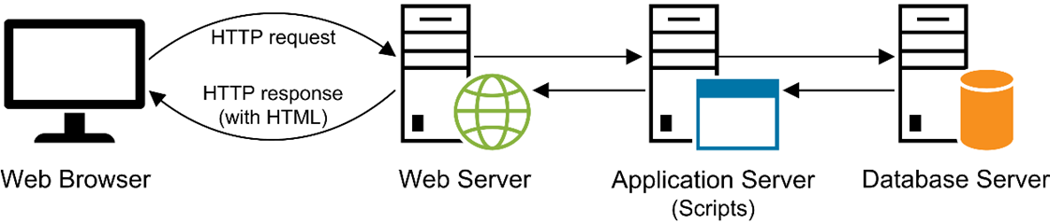
How a web server processes a dynamic web page
Terms related to dynamic web pages
dynamic web page
application server
database server
round trip
server-side processing

Slide 9
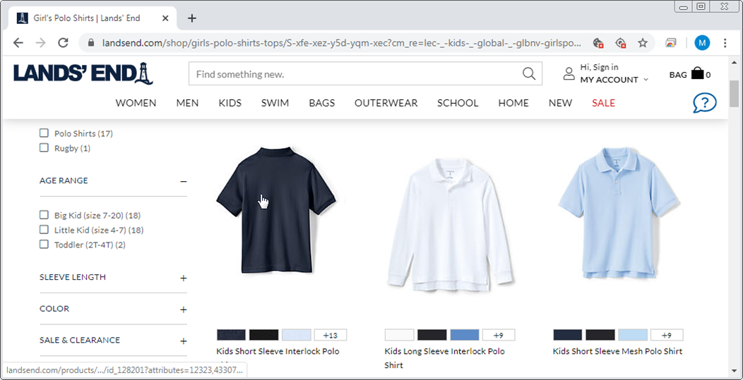
A web page with image swaps and rollovers

Slide 10
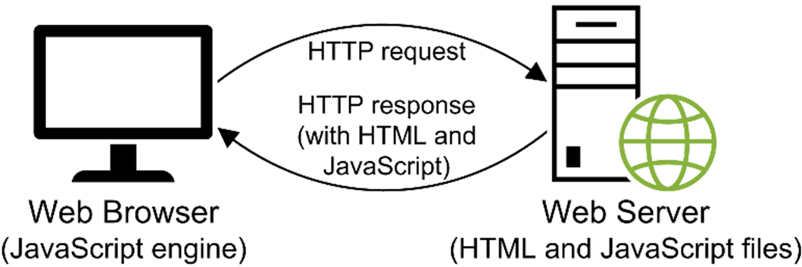
How JavaScript fits into this architecture
Terms related to client-side processing
scripting language
JavaScript engine
jQuery
client-side processing

Slide 11
Three of the many uses of JavaScript and jQuery
Data validation
Image swaps and rollovers
Slide shows

Slide 12
The versions and release dates of the ECMAScript specification
Version Release date
1 June 1997
2 June 1998
3 December 1999
4 Abandoned (never released)
5 December 2009
5.1 June 2011
2015 June 2015
2016 June 2016
2017 June 2017
2018 June 2018
2019 June 2019
2020 June 2020

Slide 13
Some additions in recent versions (part 1)
ES5
Allows you to run in strict mode.
Adds several methods that make it easier to work with arrays and objects.
Adds a built-in way to work with JavaScript Object Notation (JSON).
ES2015 (ES6)
Adds several syntactic improvements that make code easier to read and understand.
Adds block scope and easier ways to work with classes.
Adds arrow functions, iterators, and Promises for working with asynchronous code.

Slide 14
Some additions in recent versions (part 2)
ES2016
Adds a simpler syntax for computation with powers.
Adds a method to check if an array includes a specified element.
ES2017
Adds async functions and the await keyword for working with Promises.
ES2018
Adds asynchronous iteration.
Adds more regular expression features.

Slide 15
Some additions in recent versions (part 3)
ES2019
Adds new string, array, and object methods.
Adds improvements to the JSON object.
ES2020
Adds a new BigInt data type.
Adds new operators for dealing with nulls.

Slide 16
The browsers that support ECMAScript
Browser Version
Chrome 79 and above
Edge 79 and above
Firefox 68 and above
Opera 66 and above
Safari 12.1 and above
The URL for a browser compatibility table
http://kangax.github.io/compat-table/
Note
At the time of this writing, the features of ECMAScript through ES2019 are supported by all the modern browsers listed here.

Slide 17
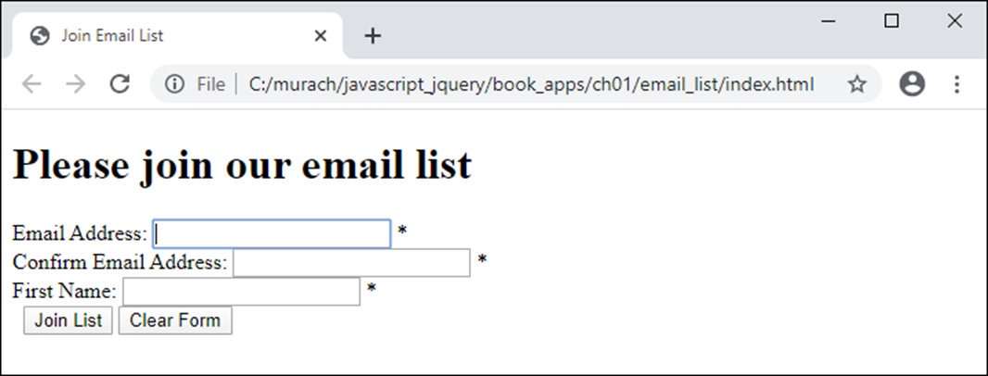
An HTML file (index.html) in a browser with no CSS applied to it

Slide 18
The HTML file named index.html (part 1)
<!DOCTYPE html>
<html>
<head>
<meta charset="utf-8" />
<meta name="viewport"
content="width=device-width, initial-scale=1">
<title>Join Email List</title>
<!-- link and style elements go here -->
</head>
<body>
<main>
<h1>Please join our email list</h1>
<form id="email_form" action="join.html"
method="get">
<div>
<label for="email_1">Email Address:
</label>
<input type="text" id="email_1"
name="email_1">
<span id="email_1_error">*</span>
</div>

Slide 19
The HTML file named index.html (part 2)
<div>
<label for="email_2">
Re-enter Email Address:</label>
<input type="text" id="email_2" name="email_2">
<span id="email_2_error">*</span>
</div>
<div>
<label for="first_name">First Name</label>
<input type="text" id="first_name"
name="first_name">
<span id="first_name_error">*</span>
</div>
<div>
<label>&nbsp;</label>
<input type="submit" id="join_list"
value="Join List">
<input type="button" id="clear_form"
value="Clear Form">
</div>
</form>
</main>
<!-- script elements go here -->
</body>
</html>

Slide 20
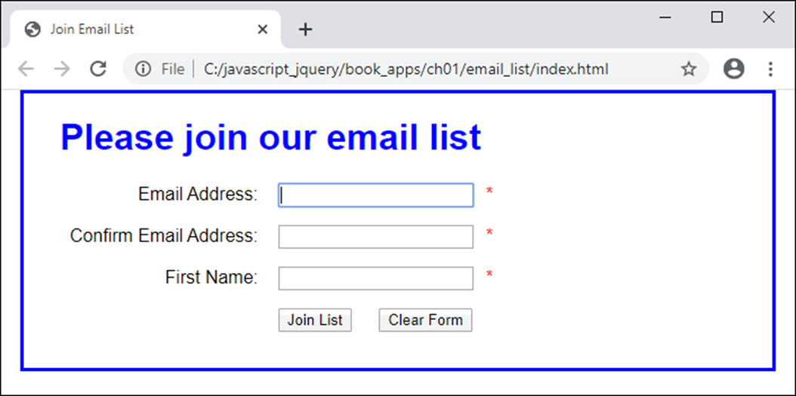
The web page in a browser after CSS has been applied to it

Slide 21
The link element in the HTML head element that applies the CSS file
<link rel="stylesheet" href="email_list.css">
The CSS file named email_list.css (part 1)
body {
font-family: Arial, Helvetica, sans-serif;
background-color: white;
margin: 0 auto;
width: 670px;
border: 3px solid blue;
padding: 0 2em 1em;
}
h1 {
color: blue;
}

Slide 22
The CSS file named email_list.css (part 2)
div {
margin-bottom: 1em;
}
label {
display: inline-block;
width: 11em;
text-align: right;
}
input {
margin-left: 1em;
margin-right: 0.5em;
}
span {
color: red;
}

Slide 23
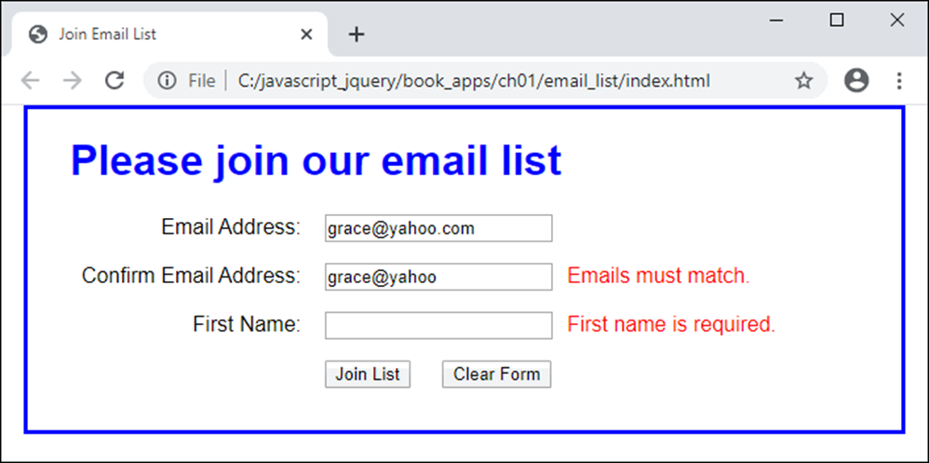
The web page in a browser with JavaScript used for data validation
The script element in the HTML body element that adds the JavaScript file
<script src="email_list.js"></script>

Slide 24
The email_list.js file (part 1)
const $ = selector => document.querySelector(selector);
const joinList = evt => {
// get user entries from text boxes
const email1 = $("#email_1").value;
const email2 = $("#email_2").value;
const firstName = $("#first_name").value;
// check user entries
let isValid = true;
if (email1 == "") {
$("#email_1_error").textContent = "Email is required.";
isValid = false;
} else {
$("#email_1_error").textContent = "";
}
if (email1 != email2) {
$("#email_2_error").textContent = "Emails must match.";
isValid = false;
} else {
$("#email_2_error").textContent = "";
}

Slide 25
The email_list.js file (part 2)
if (firstName == "") {
$("#first_name_error").textContent =
"First name is required.";
isValid = false;
} else {
$("#first_name_error").textContent = "";
}
// cancel form submit if any user entries are invalid
if ( !isValid ) {
evt.preventDefault();
}
};

Slide 26
The email_list.js file (part 3)
const clearForm = () => {
// clear text boxes
$("#email_1").value = "";
$("#email_2").value = "";
$("#first_name").value = "";
// clear span elements
$("#email_1_error").textContent = "*";
$("#email_2_error").textContent = "*";
$("#first_name_error").textContent = "*";
// set focus on first text box after resetting the form
$("#email_1").focus();
};
document.addEventListener("DOMContentLoaded", () => {
// hook up click events for both buttons
$("#join_list").addEventListener("click", joinList);
$("#clear_form").addEventListener("click", clearForm);
// set focus on first text box after the form loads
$("#email_1").focus();
});

Slide 27
The primary HTML5 semantic elements
header
main
section
article
aside
nav
figure
footer

Slide 28
A page that’s structured with HTML5 elements
<body>
<header>
<h1>San Joaquin Valley Town Hall</h1>
</header>
<main>
<p>Welcome to San Joaquin Valley Town Hall. We have some fascinating speakers for you this
season!</p>
</main>
<footer>
<p>&copy; San Joaquin Valley Town Hall.</p>
</footer>
</body>

Slide 29
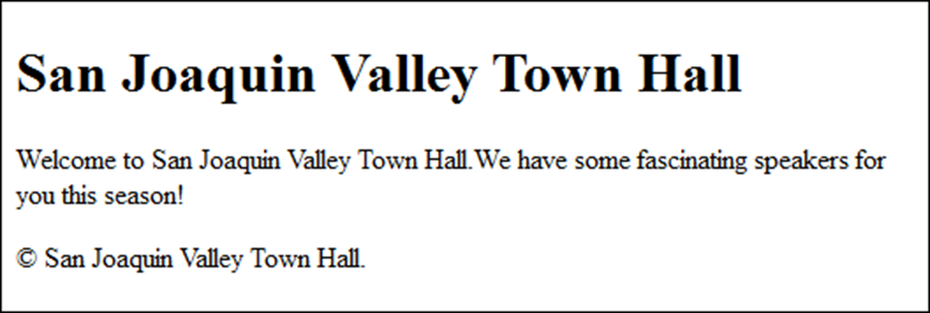
The page displayed in a web browser
The CDN for the JavaScript shiv for HTML5 compatibility
http://cdnjs.cloudflare.com/ajax/libs/html5shiv/3.7.3/html5shiv.js

Slide 30
The div and span elements
Element Description
div A block element that provides a container for other elements.
span An inline element that lets you identify text that can be formatted with CSS.

Slide 31
HTML div elements for a JavaScript application
<section id="faqs">
<h1>jQuery FAQs</h1>
<h2>What is JavaScript?</h2>
<div>
// contents
</div>
<h2>What is jQuery?</h2>
<div>
// contents
</div>
<h2>Why is jQuery becoming so popular?</h2>
<div>
// contents
</div>
</section>

Slide 32
HTML span elements for a JavaScript application
<div>
<label for="email_1">Email Address:</label>
<input type="text" id="email_1" name="email_1">
<span id="email_1_error">*</span>
</div>
<div>
<label for="email_2">Re-enter Email Address:</label>
<input type="text" id="email_2" name="email_2">
<span id="email_2_error">*</span>
</div>
<div>
<label for="first_name">First Name</label>
<input type="text" id="first_name“
name="first_name">
<span id="first_name_error">*</span>
</div>

Slide 33
The basic HTML attributes
id
class
name
for
title

Slide 34
HTML that uses these attributes
<body>
<h1>San Joaquin Valley Town Hall</h1>
<h2 class="first_h2">Welcome to San Joaquin Valley
Town Hall.</h2>
<p>Please enter your e-mail address to subscribe to
our newsletter.</p>
<form id="email_form" name="email_form"
action="join.html" method="get">
<label for="email">E-Mail: </label>
<input type="text" id="email" name="email"
title="Enter e-mail address here.">
<input type="button" value="Subscribe">
</form>
</body>

Slide 35
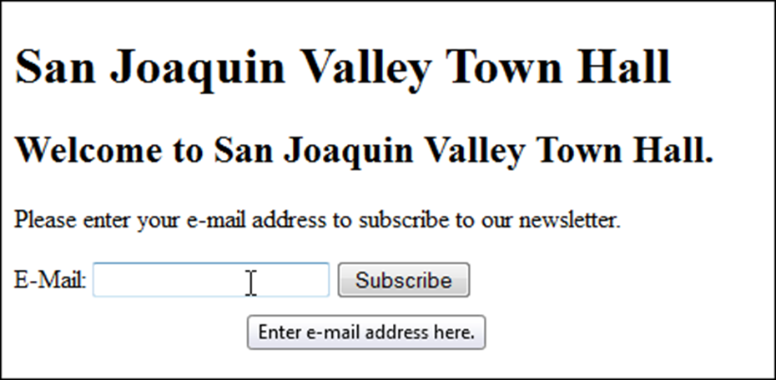
The HTML in a web browser with a tooltip displayed for the text box

Slide 36
Two ways to provide styles
Use an external style sheet by coding a link element in the head section
<link rel="stylesheet" href="styles/main.css">
Embed the styles in the head section
<style>
body {
font-family: Arial, Helvetica, sans-serif;
font-size: 87.5%; }
h1 { font-size: 250%; }
</style>
The sequence in which styles are applied
Styles from an external style sheet
Embedded styles

Slide 37
A head element that includes two style sheets
<head>
<title>San Joaquin Valley Town Hall</title>
<link rel="stylesheet" href="../styles/main.css">
<link rel="stylesheet" href="../styles/speaker.css">
</head>
The sequence in which styles are applied
From the first external style sheet to the last

Slide 38
HTML that can be selected by type, id, or class
<body>
<main>
<h1>The Speaker Lineup</h1>
<p class="blue">October 19: Jeffrey Toobin</p>
<p class="blue">November 16: Andrew Ross Sorkin</p>
</main>
<footer>
<p id="copyright" class="blue right">
Copyright SJV Town Hall</p>
</footer>
</body>

Slide 39
CSS style rules that select by type, id, and class
Elements by type
body {
font-family: Arial, Helvetica, sans-serif;
width: 400px;
margin: 1em auto; }
main {
display: block;
padding: 1em;
border: 2px solid black; }
h1 { margin: 0 0 .25em; }
p { margin: .25em 0 .25em 3em; }
One element by ID
#copyright { font-size: 90%; }
Elements by class
.blue { color: blue; }
.right { text-align: right; }

Slide 40
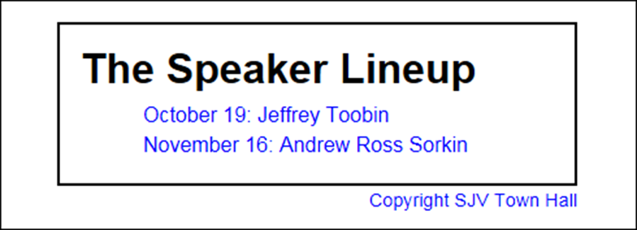
The HTML elements displayed in a browser

Slide 41
The CSS file for a typical application (part 1)
body {
font-family: Arial, Helvetica, sans-serif;
background-color: white;
margin: 0 auto;
width: 670px;
border: 3px solid blue;
padding: 0 2em 1em;
}
h1 {
color: blue;
}
div {
margin-bottom: 1em;
}
label {
display: inline-block;
width: 11em;
text-align: right;
}

Slide 42
The CSS file for a typical application (part 2)
input {
margin-left: 1em;
margin-right: 0.5em;
}
span {
color: red;
}

Slide 43
Terms related to CSS
Cascading Style Sheets (CSS)
style rule
property declaration
property name
property value

Slide 44

The web page at
c:/javascript_jquery/book_apps/ch01/email_list/index.html

Slide 45
Four ways to run an HTML page that’s on your own server or computer
From your browser, use the Ctrl+O shortcut key combination to start the Open command. Then, browse to the HTML file and double-click on it.
Use File Explorer (Windows) or Finder (macOS) to find the HTML file, and double-click on it.
Use the features of your text editor or IDE.
Click on a link in the current web page to load the next web page.

Slide 46
Two ways to run an HTML page on the Internet
Enter the URL of the web page into the browser’s address bar.
Click on a link in the current web page to load the next web page.

Slide 47

The components of an HTTP URL on the Internet
What happens if you omit parts of a URL
If you omit the protocol, the default of http:// or https:// will be used.
If you omit the filename, the default document name for the web server will be used.
The default document name is typically index.html, default.htm, or some variation.

Slide 48
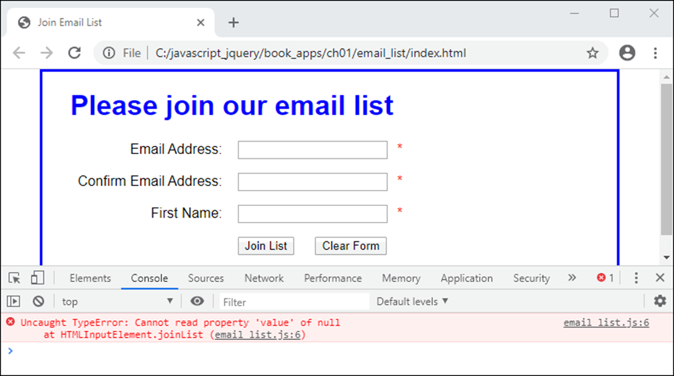
Chrome with an open Console panel that shows an error

Slide 49
How to open or close Chrome’s developer tools
To open, press F12 or Ctrl+Shift+I. Or, click on the Menu button in the upper right corner of the browser, and select More Tools→Developer Tools.
To close, click on the X in the upper right corner of the tools panel or press F12.

Slide 50
How to find the JavaScript statement that caused the error
Open the Console panel by clicking on the Console tab. You should see an error message along with the line of code that caused the error.
Click on the link to the right of the error message that indicates the line of code. That will open the Sources panel with the portion of JavaScript code that contains the statement displayed and the statement highlighted.

Slide 51
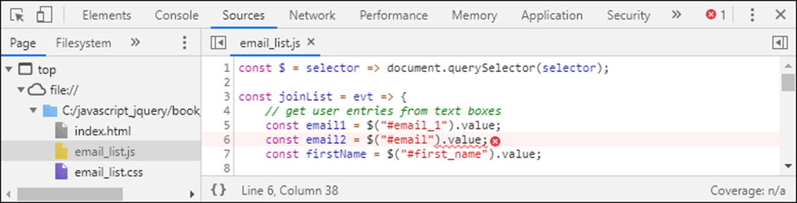
The Sources panel after the link in the Console panel has been clicked

Slide 52
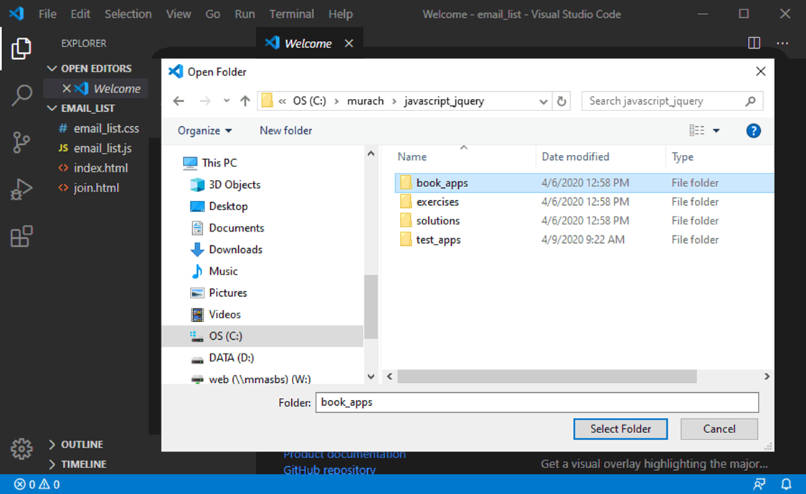
The dialog box for choosing a folder in VS Code

Slide 53
How to open a folder
Start VS Code and select File→Open Folder from the menu system.
Use the resulting dialog to select the folder that contains the files you want to work with and then click Select Folder.
How to close a folder
Select File→Close Folder from the menu system.
The folder that contains the folders for all of the book applications
\murach\javascript_jquery\book_apps

Slide 54
How to add, rename, or delete a folder
To add a folder to the main folder, point to the name of the folder in the Explorer window and click the New Folder icon that’s displayed to its right. Then, enter a name for the folder.
To add other folders, right-click on a folder in the Explorer window and select New Folder. Then, enter a name for the folder.
To rename a folder, right-click on it and select Rename. Then, edit the name.
To delete a folder, right-click on it and select Delete.

Slide 55
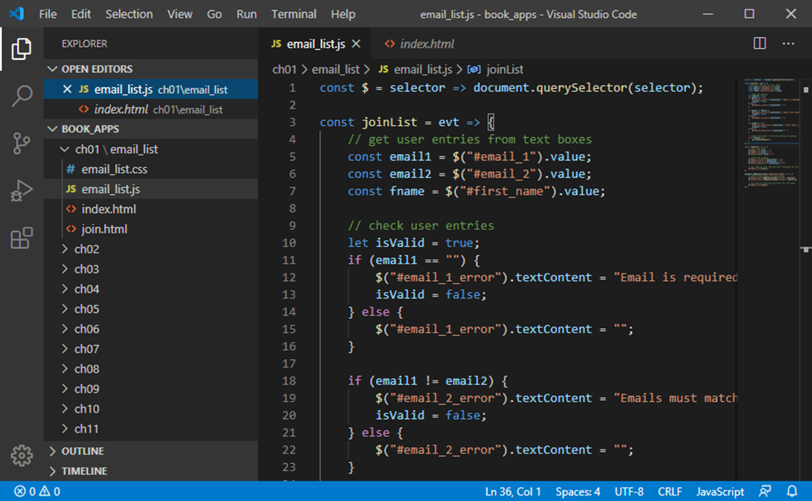
VS Code with files in Standard and Preview mode

Slide 56
How to preview or open a file
To open a file, double-click on it in the Explorer window. This displays the file in a tab in the editor with the name of the file in normal font style, indicating that you are in Standard Mode.
To preview a file, click on it in the Explorer window. This displays the file in a tab in the editor with the name of the file in italics, indicating that you are in Preview Mode. If you open or preview another file, VS Code reuses the tab.
To display a file that’s already open, click on its tab or select it from the Open Editors list at the top of the Explorer window.

Slide 57
How to close or save a file
To close a file, click the X in the upper right corner of the tab for the file, click the X to the left of the file name in the Open Editors list, or select File→Close Editor.
If you close a file with changes, you’ll be asked if you want to save the changes.
If you want to saves changes without closing a file, select File→Save. To save changes to more than one file, select File→Save All.

Slide 58
How to add, rename, or delete a file
To add a file, you use the same skills as you do for adding a folder except that you click the New File icon or select New File. When you name the file, be sure to include an extension.
VS Code doesn’t generate any starting code for new files. As a result, you must enter all code for the file yourself or use similar code from another file.
To rename or delete a file, you use the same skills as you do for renaming or deleting a folder.

Slide 59
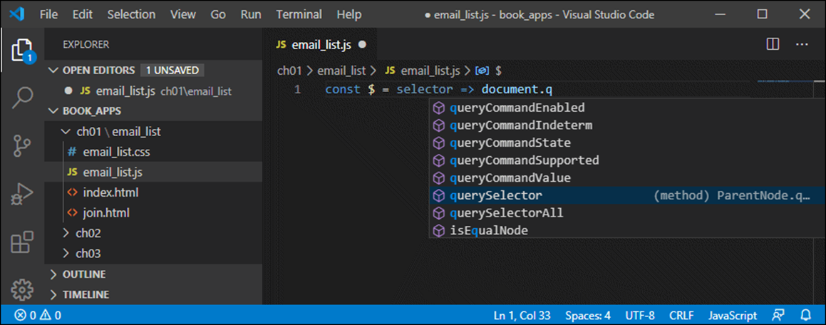
The completion list for selecting a property or method of an object

Slide 60
How to use the IntelliSense feature
IntelliSense displays completion lists for things like keywords, variables, properties, methods, and functions as you type so you can enter them correctly.
To insert an item from a completion list, click on it or highlight it and then press the Tab or Enter key.
If you enter an opening parenthesis or brace, the closing parenthesis or brace is added automatically.

Slide 61
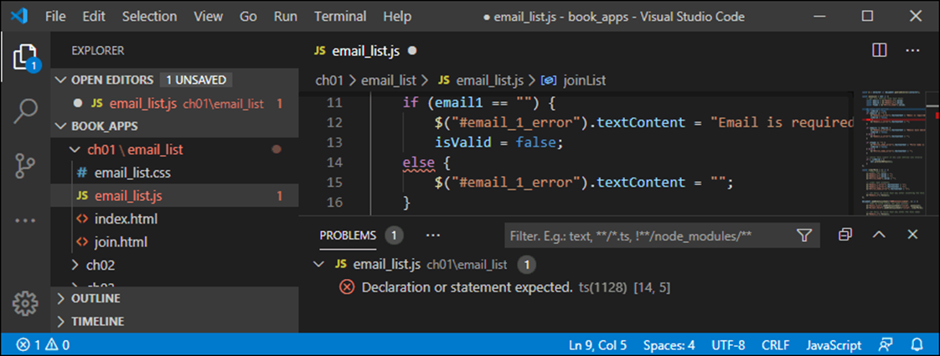
The Problems window with an error displayed

Slide 62
How to identify the errors marked by VS Code
If VS Code detects a syntax error, it underlines it with a red wavy line.
To get the description for an error, hover the mouse over the red wavy line.
To see all the errors in a file, you can display the Problems window (View→Problems). Then, you can click on an error to take you to it in the file.

Slide 63
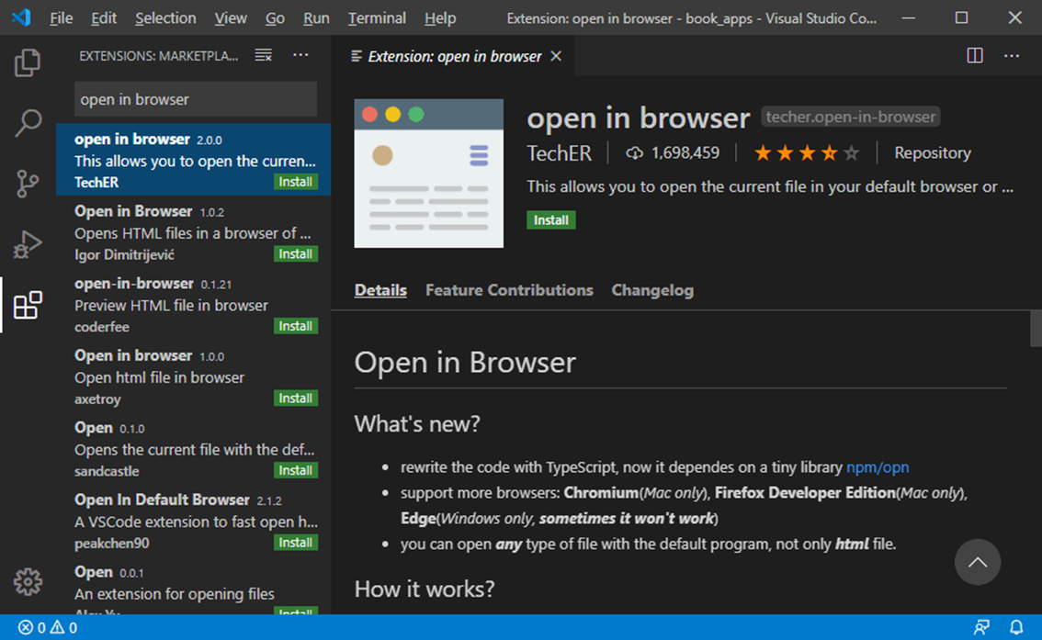
Installing the Open in Browser extension

Slide 64
How to install the Open in Browser extension
Click the Extensions icon in the left sidebar.
Enter “open in browser” in the text box at the top of the Extensions window to filter the available extensions.
Click the Install button for the Open in Browser extension from TechER. Or, click on the extension to display information about it a tab, and then click the Install button in the tab.

Slide 65
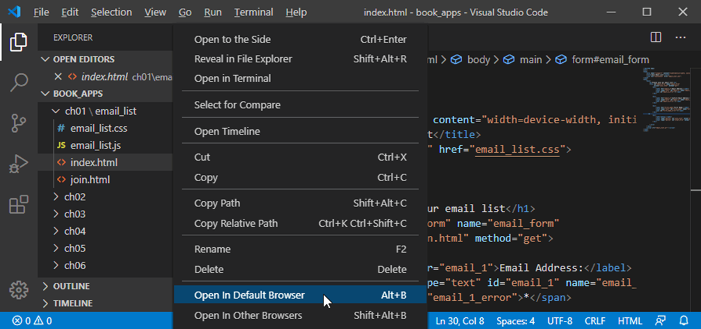
How to open an HTML file using the Open in Browser extension

Slide 66

The web page in Chrome

Slide 67
How to open an HTML file in a browser
To open an HTML file using the Open in Browser extension, right-click on the file in the Explorer window and select Open in Default Browser to open the file in your default browser.
To open an HTML file in a browser other than the default, right-click on the file, select Open In Other Browsers, and then select the browser you want to use.
To open an HTML file without using the Open in Browser extension, right-click on the file and select Reveal in File Explorer (Windows) to display it in File Explorer or Reveal in Finder (macOS) to display it in Finder. Then, you can double-click the file to open it.
Every time you open an HTML file from VS Code, another browser instance or browser tab is opened. Another alternative is to save the corrected files in VS Code, switch to the browser, and click its Reload or Refresh button.

